Slide 1
Predicting Bike Sharing Demand Kaggle Challenge 2015
Group 14
Piyush Kumar Prashant Kumar Shujaat Ishaq Swaroop Deval
a

Slide 2
Problem Statement
Bike-sharing rental process is highly correlated to the environmental and seasonal settings . Our aim is to predict the demand of bike rental count, hourly based on the relevant parameters.
BIKE SHARING DATASET - This dataset contains the hourly and daily count of rental bikes between years 2011 and 2012 in Capital bike share system with the corresponding weather and seasonal information.

Slide 3
DATASET INFORMATION
Train + Test data
9 input variables
datetime,
season,
holiday,
workingDay,
weather,
temp ,
atemp,
humidity ,
windspeed
Train Data
10887 entries
3 Outcome variables(Bike Rental Count)
Casual
Registered
Count
Test Data
6493 entries

Slide 4
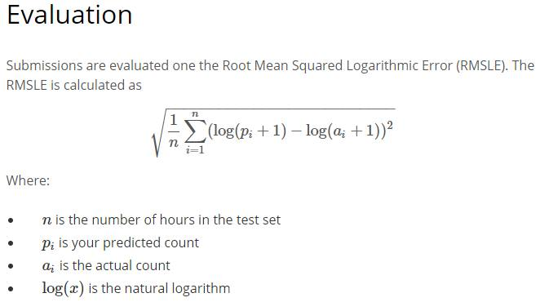
Evaluation
Ref: Kaggle challenges

Slide 5
Pre-processing the Data
Some basic conversions.
Parse ‘datetime’ entry into separate variables like ‘year’ , ‘month’ , ‘day’ and ‘hour’ removing the non-numeric data.
The variable ‘day’ serves as an index to the dataset. We introduce ‘weekday’ denoting the day at a particular week.
Scaled up count, registered and Casual to log base to ensure that RMLSE is minimized.
After prediction this is again scaled down.

Slide 6
DATA VISUALIZATION

Slide 7
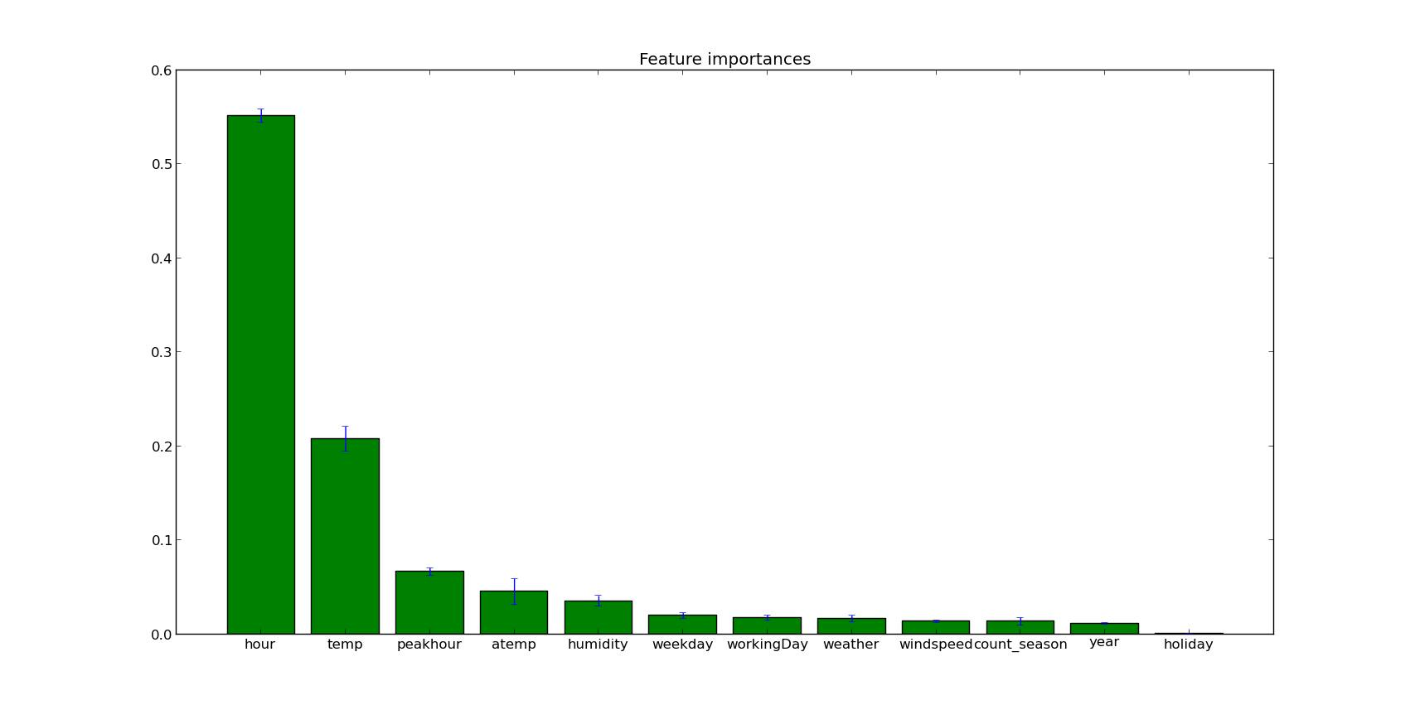
Feature Importance (Random Forest)

Slide 8
Scatter Plot of Training Set
Show on laptop!!

Slide 9
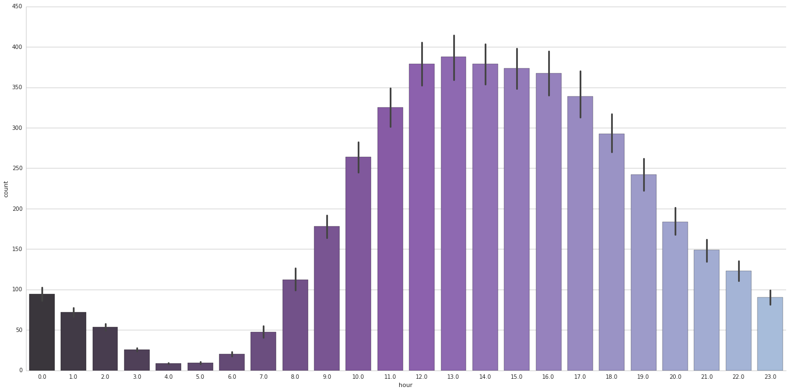
Count v/s Hour (On weekends)

Slide 10
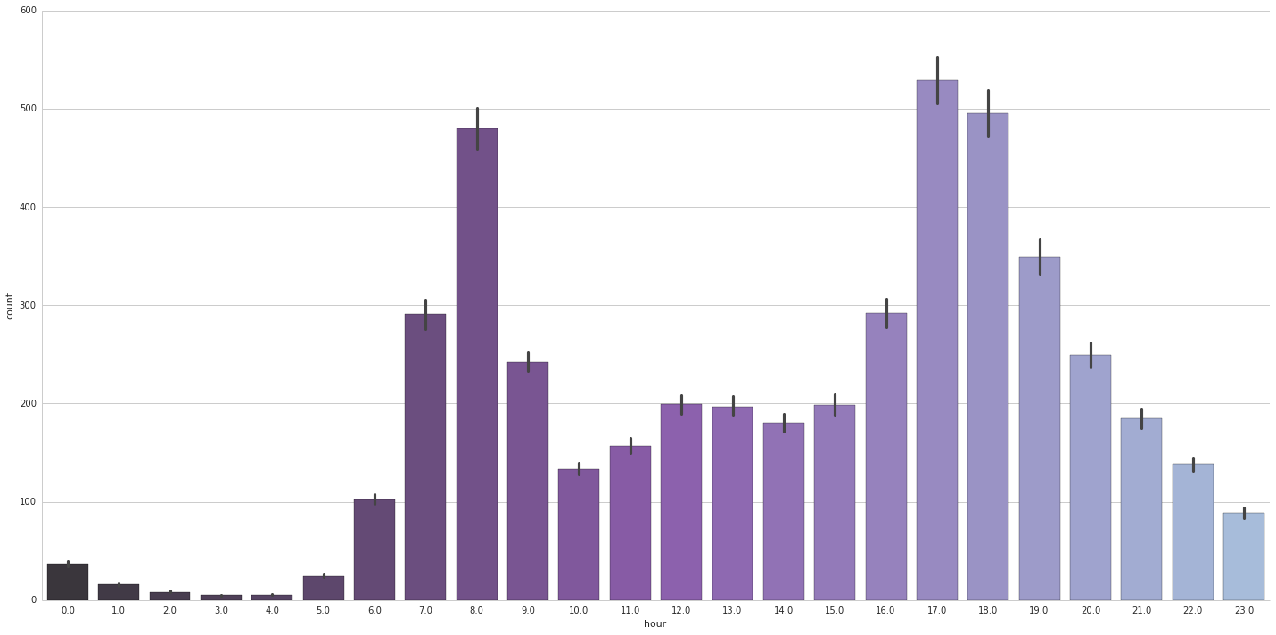
Count v/s Hour (On weekdays)

Slide 11
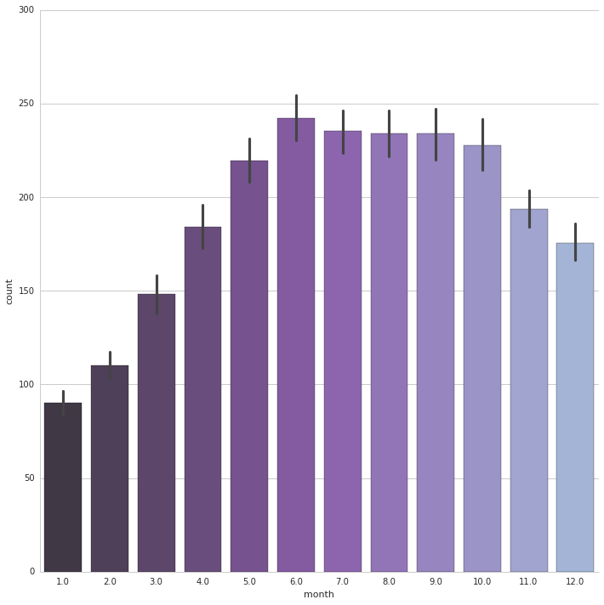
Count v/s Month

Slide 12
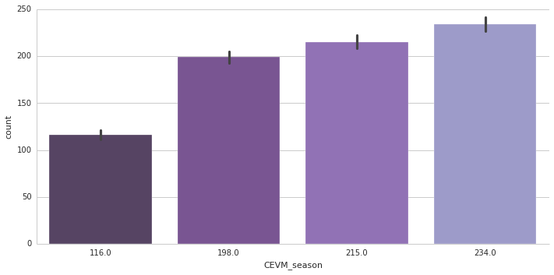
Count v/s Season

Slide 13
Feature Engineering

Slide 14
Digitization (Binarization)
Tried Approaches : Representing "Season" categorical variable with multiple Binary variables such as "Spring", "Summer", "Winter" and "Fall". Representing "Weather" categorical variable with multiple Binary variables such as "Clear", "Mist", "Rainy".

Slide 15
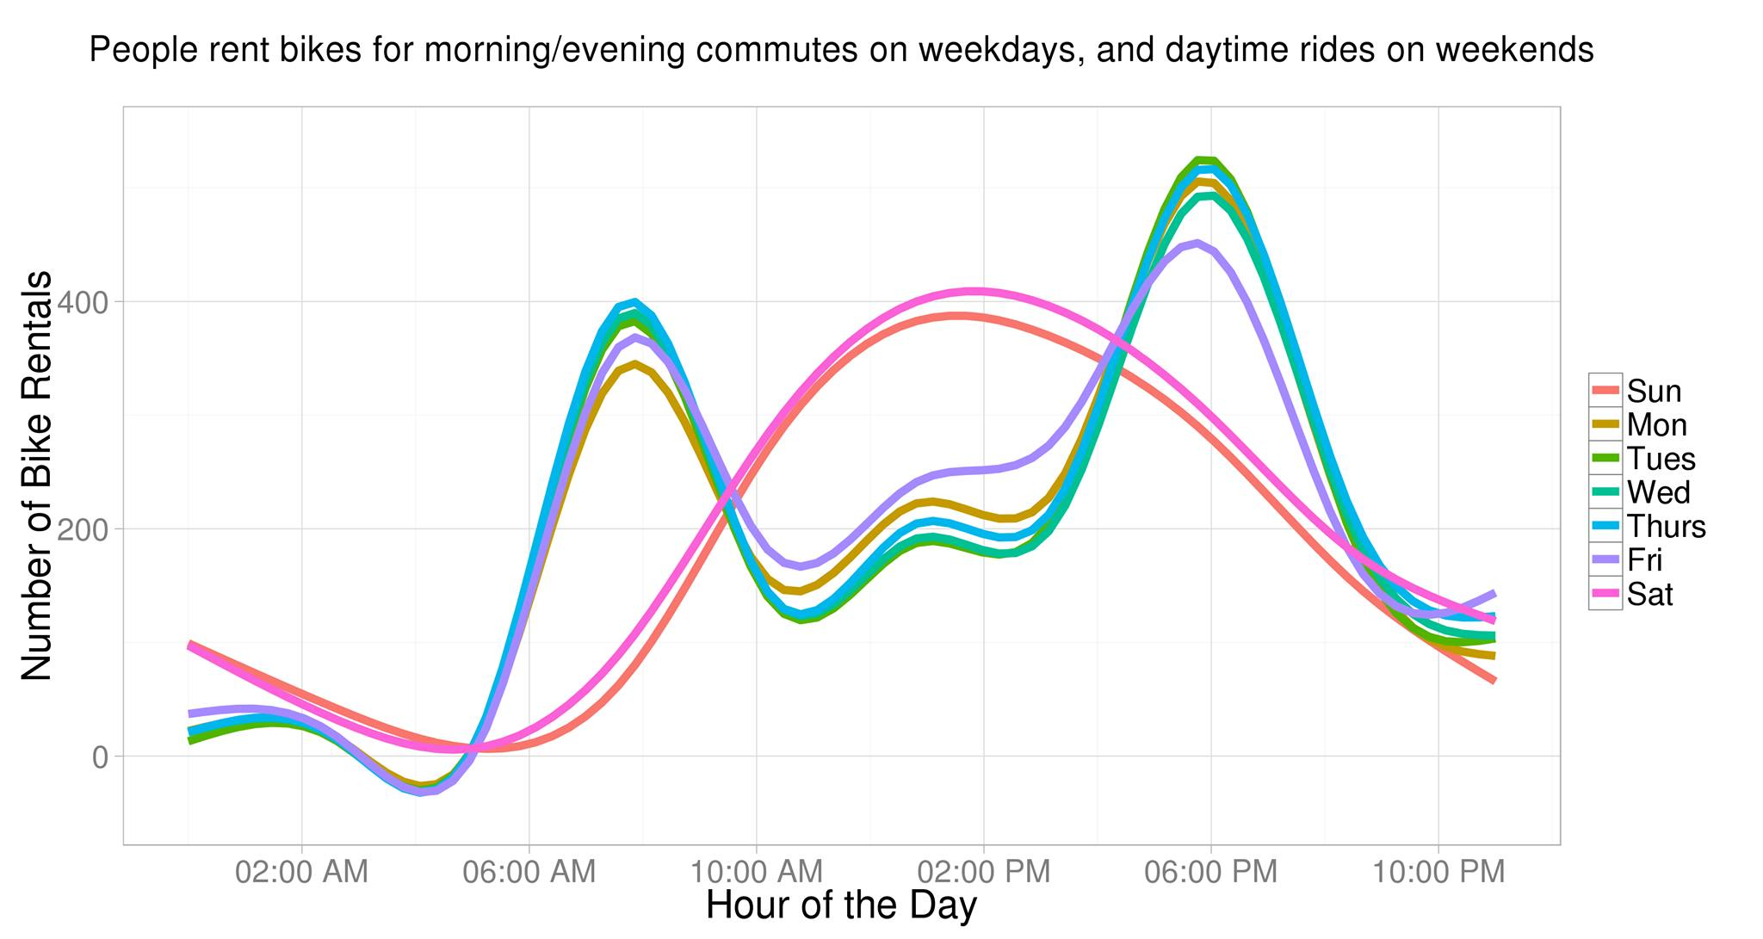
Peak Hours
Source : Kaggle Scripts

Slide 16
Other Feature Engineering Approaches
Introduced the idea of "sleep Hours".
Exploiting the high correlation between "temp" and "atemp" variable.
Low feature importance of "Holiday"
Conditional Expectation Value Mapping(CEVM) of categorical and Binary Variables.
Removed the ambiguity of "heavy rain" weather instances from test and train set.
Replaced the day variable with more relevant "weekDay" parameter.
Removed the month variable.
Source : Kaggle Scripts

Slide 17
Linear Models

Slide 18
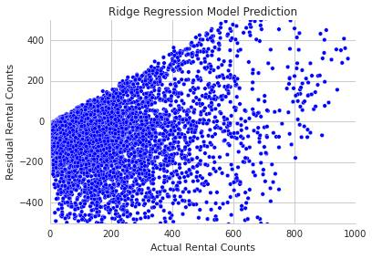
Ridge Regression
This model solves a regression model where the loss function is the linear least squares function and regularization is given by the l2-norm
Kaggle Score : 1.74

Slide 19
Lasso Regression (Basic Idea)
Give a set of input measurements x1, x2 ...xp and an outcome measurement y_pred , the lasso fits a linear model y_pred = w0 + w1*x1+ w2*x2 + ... wp*xp The criterion it uses is: Minimize sum( (y-y_pred)^2 ) subject to sum[absolute value(wj)] <= alpha
where alpha is a tuning parameter.

Slide 20
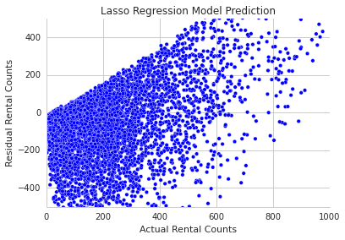
Lasso Regression (Residual plot)
Kaggle Score : 1.21

Slide 21
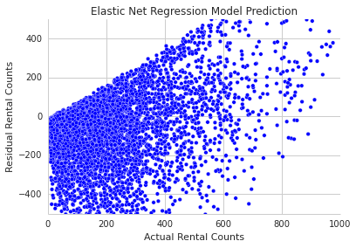
Elastic Net Residual
Elastic net is linear regression with combined L1 and L2 priors as regularizer.
Kaggle Score : 1.18

Slide 22
Data Highly Non-Linear !!

Slide 23
Non -Linear Regression Models

Slide 24
C-Tree (conditional inference tree)
"Conditional inference trees estimate a regression relationship by binary recursive partitioning in a conditional inference framework. Roughly, the algorithm works as follows: 1) Test the global null hypothesis of independence between any of the input variables and the response (which may be multivariate as well). Stop if this hypothesis cannot be rejected. Otherwise select the input variable with strongest association to the resonse. This association is measured by a p-value corresponding to a test for the partial null hypothesis of a single input variable and the response. 2) Implement a binary split in the selected input variable. 3) Recursively repeate steps 1) and 2)" [2]

Slide 25
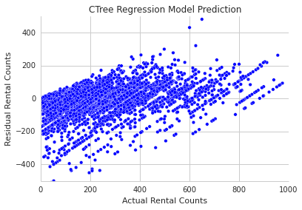
Conditional Inference Tree (Residual plot)
Kaggle Score : 0.52

Slide 26
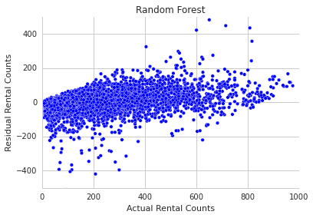
Random Forest (Residual Plot)
Hypertuned using Grid Search.
Kaggle Score : 0.3848

Slide 27
Gradient Boosting Model
"In gradient boosting machines, or simply, GBMs, the learning procedure consecutively fits new models to provide a more accurate estimate of the response variable.
The principle idea behind this algorithm is to construct the new base-learners to be maximally correlated with the negative gradient of the loss function, associated with the whole ensemble." [8]
Two parameters to tune :
Learning Rate
Number of iterations(Trees)
Used grid search for hypertuning.

Slide 28
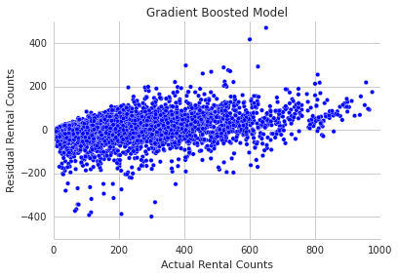
Gradient Boosting Model (Residual Plot)
Kaggle Score : 0.3672

Slide 29
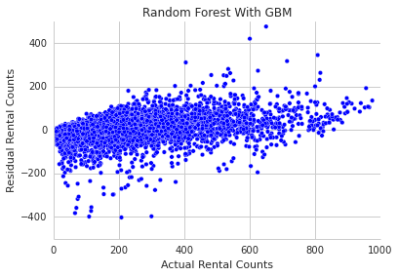
Random Forest With GBM (Majority Voting)
Kaggle Score : 0.3699

Slide 30
Other Approaches Tried
Ensemble Stacking
Neural Net
Extra Tree Regressor
SGD (Stochastic Gradient Descent Model )
SVR (Support Vector Regression)

Slide 31
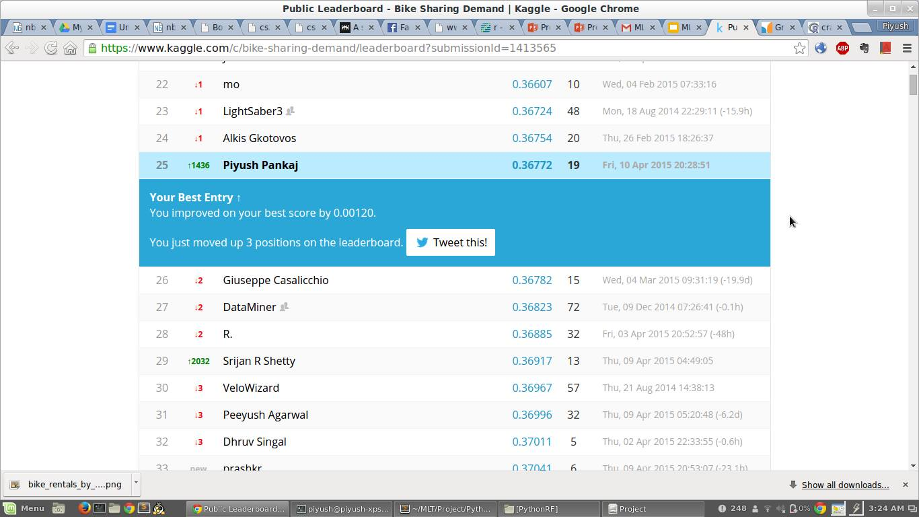
Kaggle Score

Slide 32
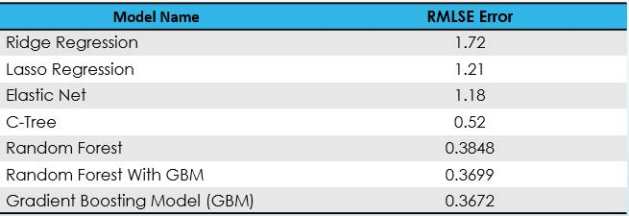
Summary of Results

Slide 33
References
1. "Kaggle Competition" - Bike Sharing Demand
2. cTree: Conditional Trees - Paper
3. Linear Regression Models : Scikit Learn
4. Bagging and Boosting Models : Ensemble Methdods sklearn
5. Gradient Boosting Model : Wikipedia
6. Ensemble Stacking :Wikipedia
7. Neural Net : 'r' Package Documentation
8. Gradient Boosting Model : http://www.ncbi.nlm.nih.gov/pmc/articles/PMC3885826/

